Slide 1
SQL Tutorial
Submitted By
Maimoona Khilji
Registration no. 195300273
BS-Data Science
Semester - IV

Slide 2
What is SQL?
SQL stands for Structured Query Language.
A computer language for:
Storing data
manipulating data
retrieving data
SQL is the standard language for Relational Database System.

Slide 3
Why SQL?
SQL is widely popular because it offers the following advantages:
It is standard language.
It is easy to understand.
Queries are short.
It allows user to describe, define, manipulate and drop the data.

Slide 4
Brief History of SQL
1970 – Dr. Edgar F. "Ted" Codd (Dr. EF. Codd) of IBM is known as the father of relational databases. He described a relational model for databases.
1974 – Structured Query Language appeared.
1986 – IBM developed the first prototype of relational database. The first relational database was released by Relational Software which later came to be known as Oracle.

Slide 5
SQL Statements
A SQL statement is a computer program or instruction that consists of identifiers, parameters, variables, names, data types, and SQL reserved words.
SQL reserved words have special meaning in SQL and should not be used for any other purpose. For example, SELECT and UPDATE are reserved words and should not be used as table names
SQL statements are divided into the following categories:
DDL - Data Definition Language
DML - Data Manipulation Language
DRL - Data Retrieval Language
DCL - Data Control Language
TCL - Transaction Control Language

Slide 6
Data Definition Language (DDL)

Slide 7
Data Definition Language (DDL) Statements
DDL or Data Definition Language actually consists of the SQL commands that can be used to define the database schema.
It simply deals with descriptions of the database schema and is used to create and modify the structure of database objects in the database. It enable you to change the structure of the database.

Slide 8
Command | Description
CREATE | It is used to create the database or its objects (like table, index, function, views, store procedure and triggers).
ALTER | It is used to alter the structure of the database. It modifies an existing database object, such as a table.
DROP | It is used to delete objects from the database like an entire table, a view of a table or other objects in the database.
TRUNCATE | It is used to remove all records from a table, including all spaces allocated for the records are removed.
COMMENT | It is used to add comments to the data dictionary.
RENAME | It is used to rename an object existing in the database.

Slide 9
Data Manipulation Language (DML)

Slide 10
Data Manipulation Language (DML) Statements
The SQL commands that deals with the manipulation of data present in the database belong to DML or Data Manipulation Language and this includes most of the SQL statements.
Command | Description
INSERT | Creates a record. It is used to insert data into a table.
UPDATE | Modifies records. It is used to update existing data within a table.
DELETE | It is used to delete records from a database table.
Notes:
Data manipulation language (DML) statements query or manipulate data in existing schema objects.
DML statements enable you to query or change the contents.
Whereas DDL statements enable you to change the structure of the database.

Slide 11
Data Retrieval Language (DRL)

Slide 12
Data Retrieval Language (DRL)
DRL or Data Retrieval Language actually consists of the SQL commands that can be used to retrieve the data from the tables of database schema
Command | Description
SELECT | Retrieves certain records from one or more tables.

Slide 13
Data Control Language (DCL)

Slide 14
Data Control Language (DCL) Statements
DCL includes commands such as GRANT and REVOKE which mainly deal with the rights, permissions and other controls of the database system
Command | Description
GRANT | It gives user’s access privileges to the database.
REVOKE | It withdraw user’s access privileges given by using the GRANT command.

Slide 15
Transaction Control Language (TCL)

Slide 16
Transaction Control Language (TCL) Statements
Transaction control statements manage the changes made by DML statements and group DML statements into transactions.
Command | Description
Commit | Make changes to a transaction permanent
Rollback | Undo the changes in a transaction, since the transaction started

Slide 17
SQL – Syntax

Slide 18
SQL - Syntax
SQL is followed by a unique set of rules and guidelines called Syntax. This tutorial gives you a quick start with SQL by listing all the basic SQL Syntax.
All the SQL statements start with any of the keywords like SELECT, INSERT, UPDATE, DELETE, ALTER, DROP, CREATE, USE, SHOW and all the statements end with a semicolon (;).
The most important point to be noted here is that SQL is case insensitive, which means SELECT and select have same meaning in SQL statements.

Slide 19
SQL- Data Definition Language

Slide 20
CREATE
CREATE DATABASE
CREATE TABLE
CREATE USER
Notes:
In Oracle, a schema is a database. Also see here - particularly this: ... In Oracle Database, a database schema is a collection of logical data structures, or schema objects [i.e. related tables]. A database schema is owned by a database user and has the same name as the user name

Slide 21
CREATE Database
Syntax:
CREATE DATABASE database_name;

Slide 22
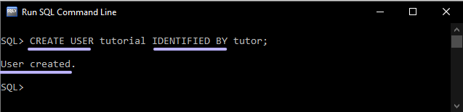
CREATE USER
Syntax:
CREATE USER user_name identified BY password;
Note: For creating user, first connect to a System.
Notes:
In Oracle, users and schemas are essentially the same thing. You can consider that a user is the account you use to connect to a database, and a schema is the set of objects (tables, views, etc.) that belong to that account.
You create users with the create user statement. This also "creates" the schema (initially empty) - you cannot create a schema as such, it is tied to the user. Once the user is created, an administrator can grant privileges to the user, which will enable it to create tables, execute select queries, insert, and everything else.
The database is the thing that contains all the users you've created, and their data (and a bunch of predefined system users, tables, views, etc. that make the whole thing work). You should look at the Oracle Database Architecture documentation in the Concepts Guide (actually, that whole page is worth a read - there's a section about users and schemas higher up in that page) to get an introduction to what a database is, and what a database instance is - two important concepts.
You can create a database with the create database statement, once you've installed the Oracle software stack.

Slide 23
CREATE Table
Syntax:
CREATE TABLE table_name
(
column1 datatype,
column2 datatype,
.....
columnN datatype
);

Slide 24
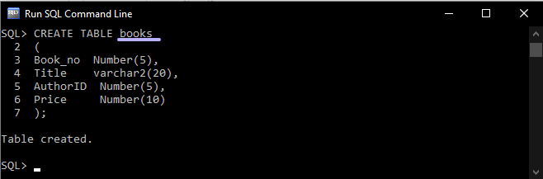
Table = Books columns are Book_no, Title, AuthorID, Price.
Notes:
Create two more tables: country and countryLanguage.

Slide 25
DDL Specifying Keys Single and Multi - Column Keys

Slide 26
CREATE Table with constraints
Single column keys can be defined at the column level instead of at the table level at the end of the field descriptions.
Multi-Column keys still need to be defined separately at the table level
Syntax:
CREATE TABLE table_name
( column1 datatype Primary Key,
column2 datatype UNIQUE,
column3 datatype,
column4 datatype,
column5 datatype,
Unique(column3, column4)
FOREIGN KEY (column5) REFERENCES table2 (column)
);

Slide 27
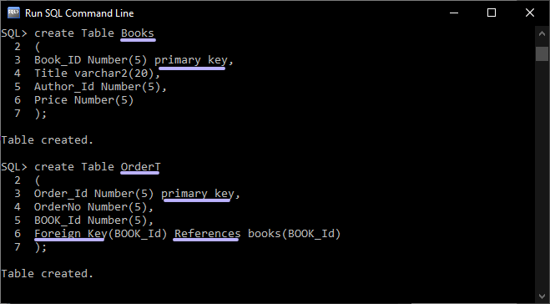
Table with Primary and Foreign Key

Slide 28
DDL Constraints Disallowing Null Values

Slide 29
Disallowing Null Values:
Null values entered into a column means that the data in not known.
These can cause problems in Querying the database.
Specifying Primary Key automatically prevents null being entered in columns which specify the primary key
Not Null clause is used in preventing null values from being entered in a column. Syntax:
CREATE TABLE table_name
(
column1 datatype Primary Key,
column2 datatype NULL,
column3 datatype NOT NULL,
column4 datatype,
Unique(column3, column4)
);

Slide 30
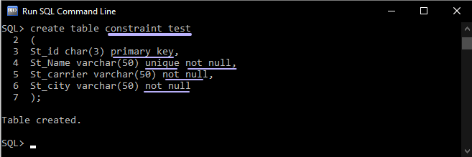
Null constraints

Slide 31
DDL Constraints- Value Constraints

Slide 32
Value Constraints:
Allows value inserted in the column to be checked condition in the column constraint.
Check clause is used to create a constraint in SQL.
Table level constraints can also be defined using the Constraint keyword
Syntax:
CREATE TABLE table_name
(
column1 datatype Primary Key check (column1 > 0),
column2 datatype,
column3 datatype,
column4 datatype,
CONSTRAINT constraint_name Check ( conditon1 and condition2) )
);

Slide 33
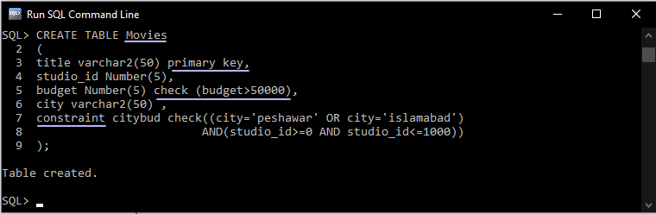
Value Constraints

Slide 34
DDL Constraints- Default Value

Slide 35
Default Value:
A default value can be inserted in any column by using the Default keyword.
Syntax:
CREATE TABLE table_name
(
column1 datatype,
column2 datatype,
column3 datatype,
column4 datatype default ‘value’
);

Slide 36
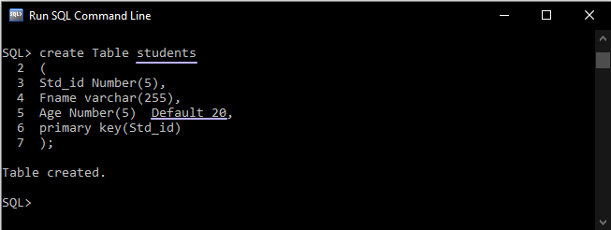
Default Value

Slide 37
Data Manipulation Language (DML)

Slide 38
INSERT
It allows you to add new records to the Table
If the columns are not specified, then data goes in the order specified in the table
Syntax:
INSERT INTO table_name
VALUES ( [value_list]);
If the columns are specified, then data goes in the order of columns specified in the column_list.
Syntax:
INSERT INTO table_name ( [column_list]) VALUES ( [value_list]);

Slide 39
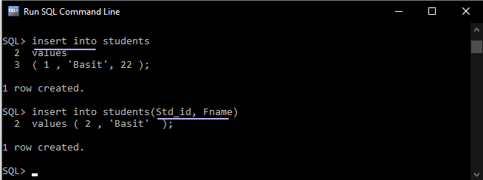
INSERT

Slide 40
INSERT INTO - SELECT
Copy all columns from one table to another table:
Syntax:
INSERT INTO table2 SELECT * FROM table1 WHERE condition;
Copy only some columns from one table into another table:
Syntax:
INSERT INTO table2 (column1, column2, column3, ...) SELECT column1, column2, column3, ... FROM table1 WHERE condition;

Slide 41
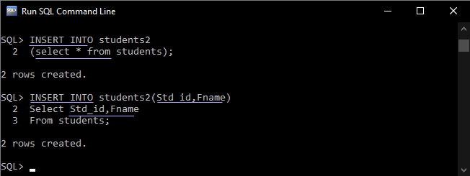
INSERT INTO - SELECT

Slide 42
DELETE
It is used to remove records from a table of the database. The where clause in the syntax is used to restrict the rows deleted from the table otherwise all the rows from the table are deleted.
Syntax:
DELETE FROM table_name
WHERE {CONDITION};

Slide 43
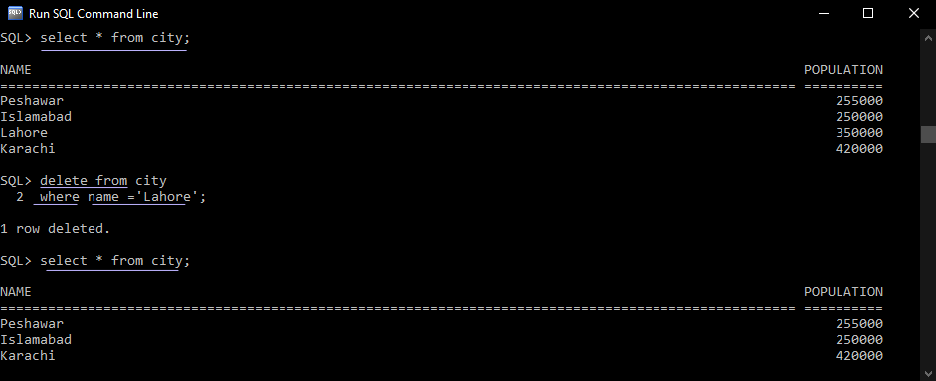
DELETE

Slide 44
TRUNCATE
It used to delete all the rows of a table. Delete can also be used to delete all the rows from the table.
The difference is that delete performs a delete operation on each row in the table while the Truncate statement simply throws away all the rows at once and is much quicker.
The note of caution is that truncate does not do integrity checks on the way which can lead to inconsistencies on the way. If there are dependencies requiring integrity checks we should use delete.
Syntax:
TRUNCATE TABLE table_name;

Slide 45
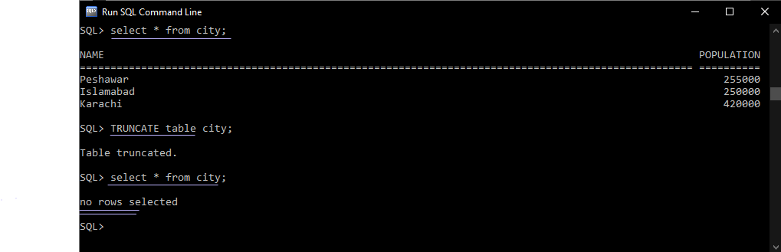
TRUNCATE

Slide 46
UPDATE
It used to make changes to existing rows of the table.
It has three parts.
First, you ,must specify which table is going to be updated.
The second part of the statement is the set clause, in which you should specify the columns that will be updated as well as the values that will be inserted.
Finally, the where clause is used to specify which rows will be updated.
Syntax:
UPDATE table_name
SET column_name1 = value1, column_name2 = value2, …..
[WHERE Condition]

Slide 47
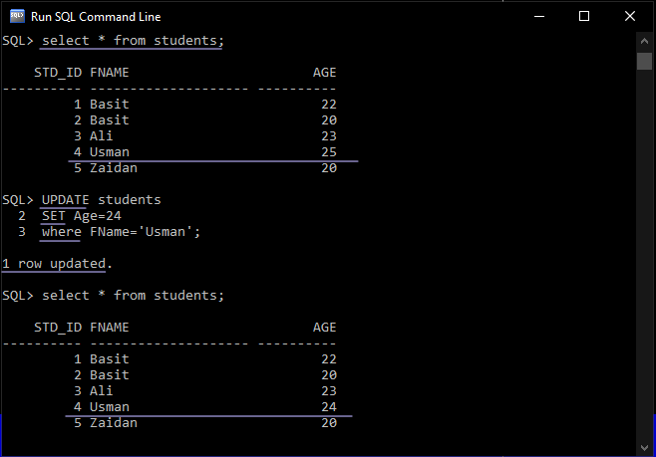
Update

Slide 48
DROP
It is used to remove elements from a database, such as tables, indexes, users and databases.
Drop command is used with a variety of keywords based on the need.
Drop Table
Drop User
Drop Database

Slide 49
DROP Database
Syntax:
DROP DATABASE database_name;

Slide 50
DROP Table
Syntax:
DROP TABLE table_name;

Slide 51
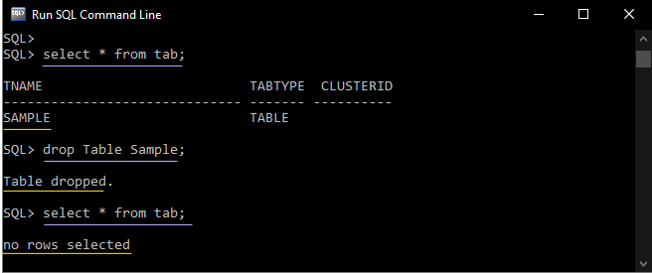
Drop table

Slide 52
DROP USER
Syntax:
DROP USER user_name;
Note:
If schema contains object, then
DROP USER user_name CASCADE;

Slide 53
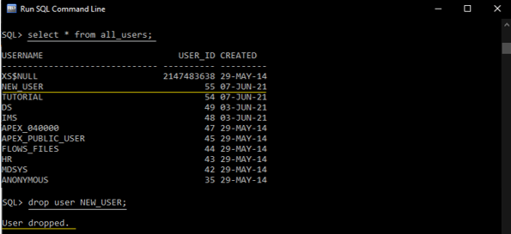
Drop User

Slide 54
ALTER
It is used to make changes to the schema of the table.
Columns can be added
Columns can be removed
Datatype of the column can be changed.
Name of the table can be renamed.

Slide 55
ALTER – Modify Column
Syntax:
ALTER TABLE table_name
MODIFY column_name {data_ype};

Slide 56
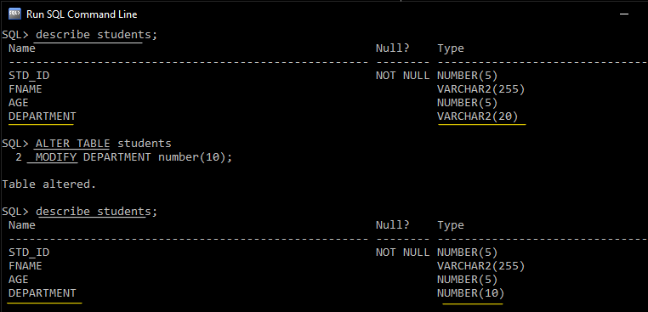
ALTER – Modify Column

Slide 57
ALTER – Drop Column
Syntax:
ALTER TABLE table_name
DROP column_name;

Slide 58
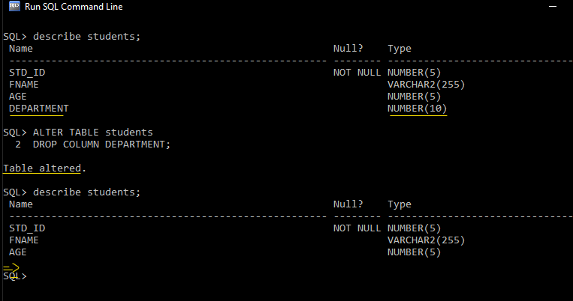
ALTER – Drop Column

Slide 59
ALTER – Add Column
Syntax:
ALTER TABLE table_name
ADD column_name {data_ype};

Slide 60
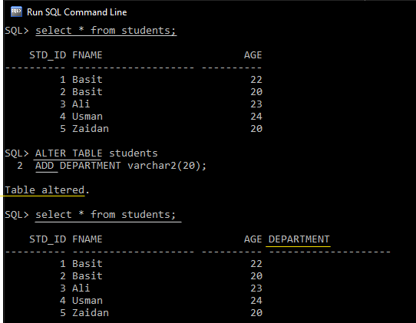
ALTER – Add Column

Slide 61
ALTER – Rename Table
Syntax:
ALTER TABLE table_name
RENAME TO new_table_name;

Slide 62
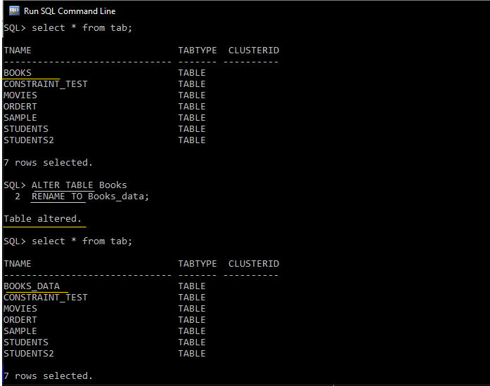
ALTER – Rename Table

Slide 63
SQL-Data Retrieval Language (DRL)

Slide 64
SELECT
SELECT identifies the columns to be displayed.
FROM identifies the table containing those columns.
Syntax:
SELECT column1, column2,....,columnN
FROM table_name;

Slide 65
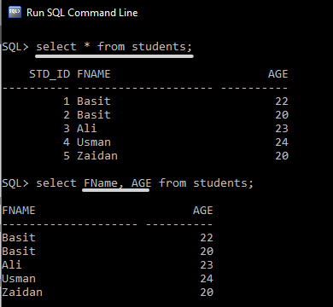
Select- single and multiple columns

Slide 66
Select Statement Using Arithmetic Operators
Syntax:
SELECT column [operator]<expression>,…
FROM table_name;
Operator | Meaning | Operates on
+ (Add) | Addition | Numeric value
- (Subtract) | Subtraction | Numeric value
* (Multiply) | Multiplication | Numeric value
/ (Divide) | Division | Numeric value
% (Modulo) | Returns the integer remainder of a division. For example, 17 % 5 = 2 because the remainder of 17 divided by 5 is 2. | Numeric value

Slide 67
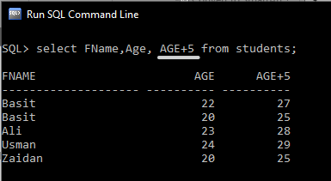
Select- using arithmetic operator

Slide 68
Operator Precedence
Operator | Meaning | Precedence
( ) | Addition | Highest Lowest
* / % | Subtraction
+ - | Multiplication
= | Division
Note: Arithmetic expressions containing a null value evaluate to null.

Slide 69
Select Statement Using Column Aliases
SQL aliases are used to give a temporary name to column in a table.
Aliases are often used to make column names more readable.
An alias only exists for the duration of that query.
An alias is created with the AS keyword.
Syntax:
SELECT column_name AS alias_name
FROM table_name;
An alias can be created without the AS keyword.
Syntax:
SELECT column_name alias_name
FROM table_name;

Slide 70
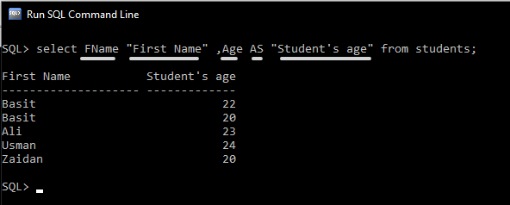
Select- Using Column Aliases

Slide 71
Select Statement Concatenation Operator
It links columns or character strings to other columns
It is represented by two vertical bars (||)
It creates a resultant column that is a character expression.
Syntax:
SELECT column_name1 | | column_name2
FROM table_name;

Slide 72
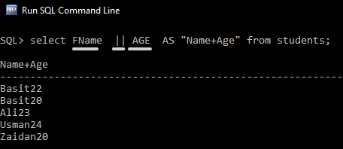
Select - Concatenation Operator

Slide 73
Select Statement Literal Character Strings
A literal is a character, a number, or a date that is included in the SELECT statement.
Date and character literal values must be enclosed within single quotation marks.
Each character string is output once for each row returned.
Syntax:
SELECT column_name1 || ‘String’ || column_name2
FROM table_name;

Slide 74
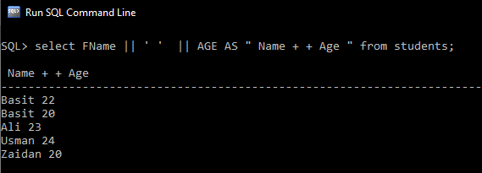
Select - Literal Character Strings

Slide 75
Select Statement Alternative Quote (q) Operator
Specify your own quotation mark delimiter.
Select any delimiter.
Increase readability and usability.
Syntax:
SELECT column_name1 || q‘ [ 's string ] ' || column_name2
FROM table_name;

Slide 76
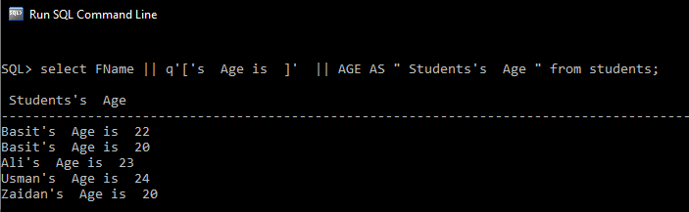
Select - Alternative Quote (q) Operator

Slide 77
Select Statement Avoid Duplicate Rows
The default display of queries is all rows, including duplicate rows.
To avoid Duplicate rows, Use keyword DISTINCT.
Syntax:
SELECT DISTINCT column_name1
FROM table_name;

Slide 78
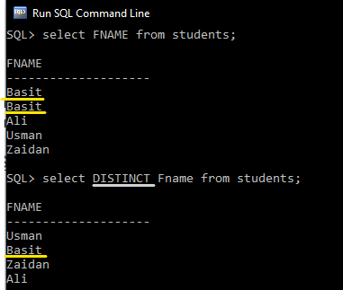
Select – Avoid Duplicate Rows

Slide 79
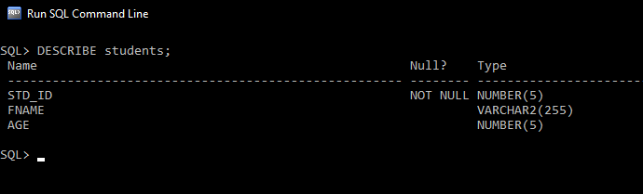
Displaying the Table Structure
Use the DESCRIBE command to display the structure of a table.
Syntax:
DESCRIBE table_name;

Slide 80
Restricting and Sorting Data

Slide 81
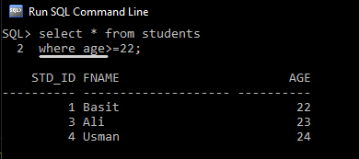
Using the WHERE Clause
Use the WHERE clause to limit the rows that are selected.
Syntax:
SELECT column1, column2, ... FROM table_name WHERE condition;

Slide 82
Operators in WHERE clause
Operator | Description
= | Equal
> | Greater than
< | Less than
>= | Greater than or equal
<= | Less than or equal
<> | Not equal. Note: In some versions of SQL this operator may be written as !=
BETWEEN | Between a certain range
LIKE | Search for a pattern
IN | To specify multiple possible values for a column

Slide 83
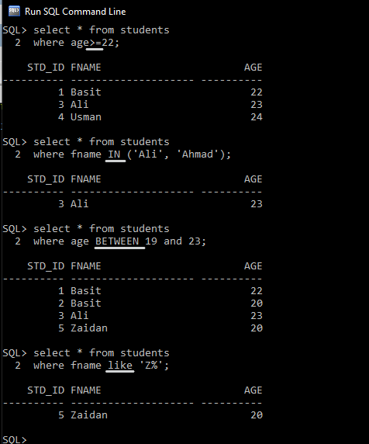
WHERE Clause

Slide 84
Using the ORDER BY Clause
Sort retrieved rows with the ORDER BY clause:
ASC: Ascending order, default
DESC: Descending order
The ORDER BY clause comes last in the SELECT statement.
Syntax:
SELECT column1, column2, ... FROM table_name ORDER BY column;

Slide 85
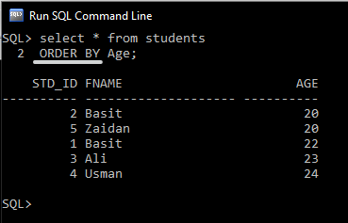
ORDER BY

Slide 86
Substitution Variables
Use substitution variables to:
Temporarily store values with single-ampersand (&) and
double-ampersand (&&) substitution
Use substitution variables to supplement the following:
WHERE conditions
ORDER BY clauses
Column expressions
Table names

Slide 87
Using the Single-Ampersand Substitution Variable
Use a variable prefixed with an ampersand (&) to prompt the user for a value:
Syntax:
SELECT column1, column2, ... FROM table_name Where column= &variable;

Slide 88
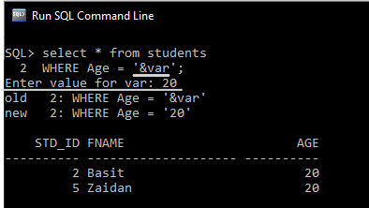
Single-Ampersand Substitution Variable

Slide 89
Using the Double-Ampersand Substitution Variable
Use double ampersand (&&) if you want to reuse the variable value without prompting the user each time.
Syntax:
SELECT column1, &&variable
FROM table_name ORDER BY &variable;

Slide 90
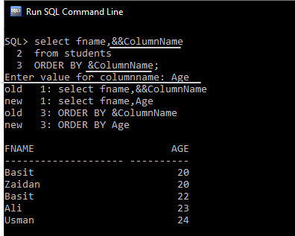
Double-Ampersand Substitution Variable

Slide 91
Using the DEFINE Command
Use the DEFINE command to create and assign a value to a variable.
Use the UNDEFINE command to remove a variable.
Syntax:
DEFINE variable =value
SELECT column1, &&variable
FROM table_name Where column= &variable;
;

Slide 92
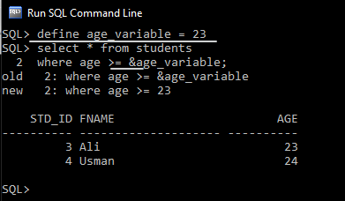
Define Command

Slide 93
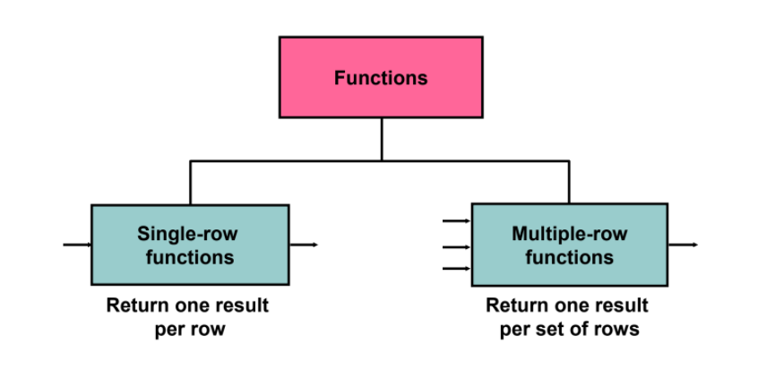
Functions in SQL

Slide 94
Single-row Functions

Slide 95
Single-row Functions
Single row functions are those function that give one result per row.
The single row functions are:
Character Functions
Number Functions
Date Functions

Slide 96
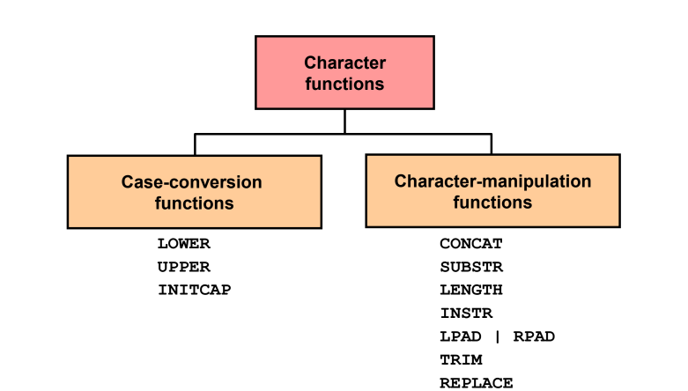
Character Functions

Slide 97
Case-Conversion Functions
These functions convert the case for character strings:
Syntax:
SELECT column1, column2, ... FROM table_name Where Function(column) = value;
Function | Result
LOWER('SQL Course') | sql course
INITCAP('SQL Course') | Sql Course
UPPER('SQL Course') | SQL COURSE

Slide 98
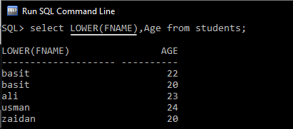
Case Conversion - LOWER

Slide 99
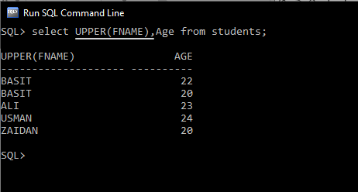
Case Conversion - UPPER

Slide 100
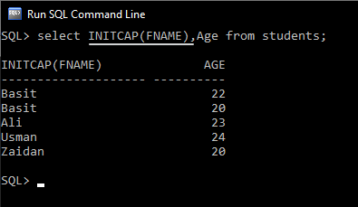
Case Conversion - INITCAP

Slide 101
Character-Manipulation Functions
These functions manipulate character strings:
Syntax:
SELECT column1, Function(column2) , ... FROM table_name Where Function(column)= value;
Function | Result
CONCAT('Hello', 'World') | HelloWorld
SUBSTR('HelloWorld',1,5) | Hello
LENGTH('HelloWorld') | 10
INSTR('HelloWorld', 'W') | 6
LPAD(salary,10,'*') | *****24000
RPAD(salary, 10, '*') | 24000*****
REPLACE ('JACK and JUE','J','BL') | BLACK and BLUE
TRIM('H' FROM 'HelloWorld') | elloWorld

Slide 102
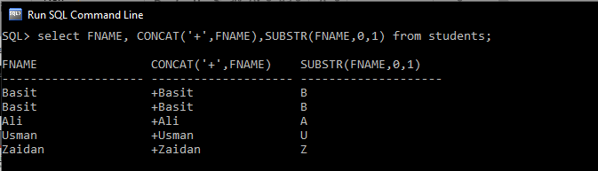
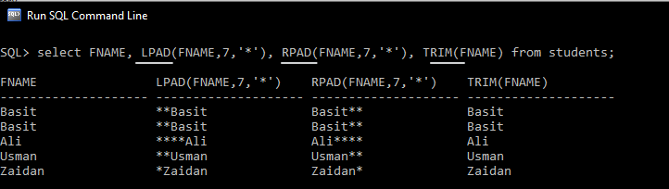
Character-Manipulation Functions

Slide 103
Number Functions
ROUND: Rounds value to a specified decimal
TRUNC: Truncates value to a specified decimal
MOD: Returns remainder of division
Syntax:
SELECT column1, Function(column2) , ... FROM table_name Where Function(column)= value;
Function | Result
ROUND(1.268, 2) | 1.27
TRUNC(1.268, 2) | 1.26
MOD(5, 2) | 1

Slide 104
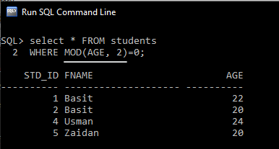
Number Functions-MOD

Slide 105
Date-Manipulation Functions
Function | Result | Use of function | Result
MONTHS_BETWEEN | Number of months between two dates | MONTHS_BETWEEN ( '01-SEP-95‘ , '11-JAN-94‘ ) | 19.6774194
ADD_MONTHS | Add calendar months to date | ADD_MONTHS (‘31-JAN-96',1) | ‘29-FEB-96'
NEXT_DAY | Next day of the date specified | NEXT_DAY ('01-SEP-95','FRIDAY') | '08-SEP-95'
LAST_DAY | Last day of the month | LAST_DAY ('01-FEB-95') | '28-FEB-95'
ROUND | Round date | ROUND ( '25-MAY-93 ‘ , 'YEAR') | ‘01-JAN-94'
TRUNC | Truncate date | TRUNC ( '25-MAY-93 ‘ , 'YEAR') | ‘01-JAN-93'

Slide 106
Multiple-row Functions

Slide 107
Multiple-row Functions
Multiple row functions are those function that give one result per row.
Multiple row functions are Group functions.
Group functions operate on sets of rows to give one result per group.

Slide 108
GROUP Functions
Types of Group COUNT
MAX
MIN
STDDEV
SUM
VARIANCE
Syntax:
SELECT group_function (column), ...
FROM table
[WHERE condition]
[ORDER BY column];

Slide 109
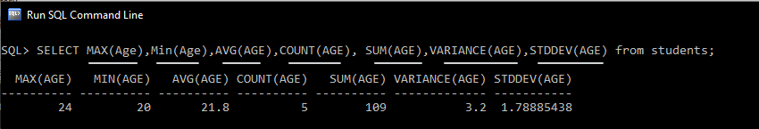
GROUP Functions

Slide 110
Grouping rows
Grouping rows:
GROUP BY clause
HAVING clause

Slide 111
GROUP BY
Creating Groups of Data using GROUP BY Clause.
You can divide rows in a table into smaller groups by using the GROUP BY clause.
Syntax:
SELECT column, group_function(column)
FROM table
GROUP BY column;

Slide 112
Grouping by More than One Column
Using the GROUP BY Clause on Multiple Columns
Syntax:
SELECT column1, column2, group_function(column)
FROM table
GROUP BY column1, column2;

Slide 113
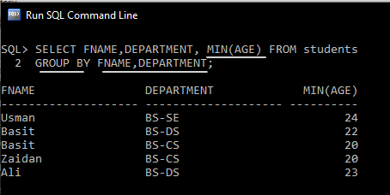
Grouping by More than One Column

Slide 114
Having clause
When you use the HAVING clause, the Oracle server restricts groups as follows:
Rows are grouped.
The group function is applied.
Groups matching the HAVING clause are displayed.
Syntax:
SELECT column, group_function(column)
FROM table
GROUP BY column
Having group_condition;

Slide 115
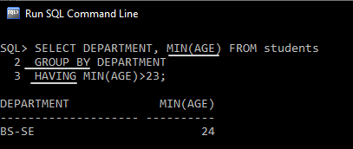
Having clause

Slide 116
Displaying Data from Multiple Tables

Slide 117
Types of Joins
Natural joins:
NATURAL JOIN clause
USING clause
ON clause
Outer joins:
LEFT OUTER JOIN
RIGHT OUTER JOIN
FULL OUTER JOIN
Cross joins

Slide 118
Difference between Natural Joins, Using, and ON Join
Natural Joins | Using Clause | ON Clause
It is used to join two tables on the basis of identical columns that have same names and same data types | It is used to join two tables on the basis of multiple columns with same name | It is used to join two tables on the basis of columns that have different names.

Slide 119
Natural Joins
The NATURAL JOIN clause is based on all columns in the two tables that have the same name.
It selects rows from the two tables that have identical column names and data types.
If the columns having the same names have different data types, an error is returned.
Syntax:
SELECT Table1.column, Table2.column
FROM Table1
NATURAL JOIN Table2 ;

Slide 120
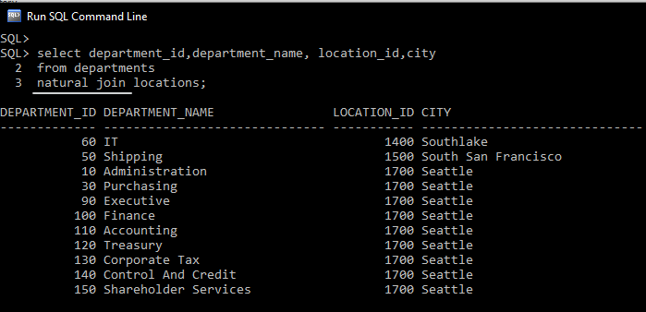
Natural Joins

Slide 121
Creating Joins with the USING Clause
If several columns have the same names but the data types do not match, natural join can be applied using the USING clause to specify the columns that should be used for an equijoin.
Use the USING clause to match only one column when more than one column matches.
The NATURAL JOIN and USING clauses are mutually exclusive.
Syntax:
SELECT Table1.column, Table2.column
FROM Table1
JOIN Table2
USING join_column;

Slide 122
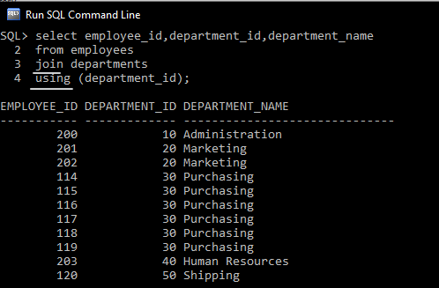
Joins - USING Clause

Slide 123
Creating Joins with the ON Clause
The join condition for the natural join is basically an equijoin of all columns with the same name.
Use the ON clause to specify arbitrary conditions or specify columns to join.
The join condition is separated from other search conditions.
The ON clause makes code easy to understand.
Syntax:
SELECT Table1.column, Table2.column
FROM Table1
JOIN Table2
ON ( Table1.column_name = Table2.column_name ) ;

Slide 124
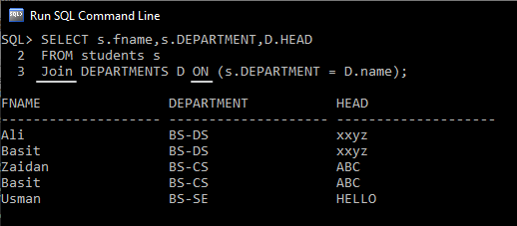
Joins with the ON Clause

Slide 125
Applying Additional Conditions
to a Join
Use the AND clause or the WHERE clause to apply additional conditions
Syntax:
SELECT Table1.column, Table2.column
FROM Table1
JOIN Table2
ON ( Table1.column_name = Table2.column_name )
AND [condition] ;
Syntax:
SELECT Table1.column, Table2.column
FROM Table1
JOIN Table2
ON ( Table1.column_name = Table2.column_name )
WHERE [condition] ;

Slide 126
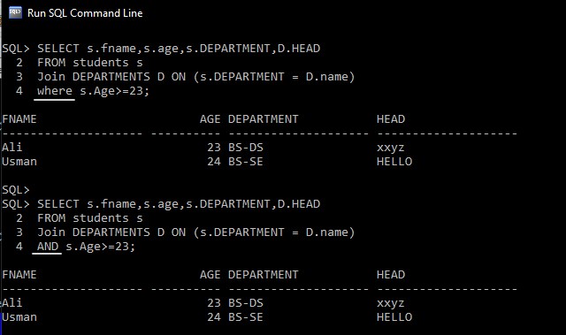
Conditions to a Join

Slide 127
SQL-Data Control Language (DCL)

Slide 128
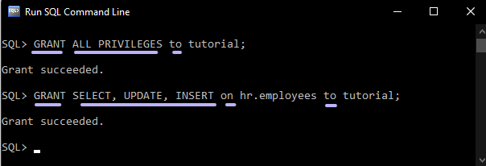
GRANT
Syntax:
GRANT type_of_permission TO username;
GRANT type_of_permission ON database_name.table_name
TO username;

Slide 129
How To Grant Different User Permissions
Here is a short list of other common possible permissions that users can enjoy.
Permissions | Description
ALL PRIVILEGES | This would allow a user full access to a designated database (or if no database is selected, global access across the system)
CREATE | allows them to create new tables or databases
DROP | allows them to them to delete tables or databases
DELETE | allows them to delete rows from tables
INSERT | allows them to insert rows into tables
SELECT | allows them to use the SELECT command to read through databases
UPDATE | allow them to update table rows
GRANT OPTION- | allows them to grant or remove other users’ privileges

Slide 130
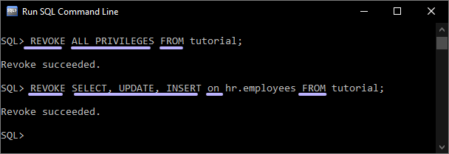
REVOKE
Syntax:
REVOKE type_of_permission FROM username;
REVOKE type_of_permission ON database_name.table_name
FROM username;

Slide 131
THE END

